Slide 1
Troubleshooting VidyoConferencing Solutions

Slide 2
Objectives
Describe the Vidyo Call Flow
Troubleshoot Common Vidyo Issues
Properly escalate issues to Vidyo Support
Access additional troubleshooting resources when needed
‹#›

Slide 3



Vidyo Team – Subject Matter Experts
Bill Santiago
Technical Trainer
Chris Arnold
Senior Customer Support Engineer
LaMar Medler
Senior VidyoGateway Customer Support Engineer
‹#›

Slide 4
Webinar Protocol
We will aim to answer as many questions as possible at the end of the webinar
All attendees will be silenced during training delivery
Please place your camera into privacy mode during the session, unless you have an urgent question that is related to the topic being covered.
Please remain in privacy mode during the Q&A session unless you have a question.
Alternatively, questions may be sent to: training@vidyo.com
‹#›

Slide 5
Agenda
Vidyo Call Flow Overview
Common Issues
VidyoDesktop
VidyoRoom
VidyoGateway
Gathering General Information and Vidyo Logs
VidyoDesktop DOs and DON’Ts Checklist
Vidyo Escalation Best Practices
Additional Resources
Q&A Session
‹#›

Slide 6
Vidyo Call Flow Overview

Slide 7

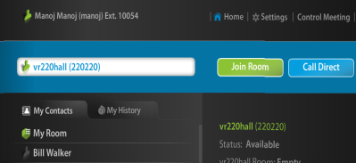
VidyoConferencing 2.0
All ports reflected in this diagram are TCP.
SOAP: 80/443
VidyoPortal
Web Services
SOAP: 80/443
SOAP:80
HTTP/HTTPS: 80/443
SOAP:17995
VidyoManager
RMCP(S): 17991
HTTP: 63457
VidyoGateway
VidyoDesktop
VidyoRouter
EMCP(S): 17992
EMCP(S): 17992
Virtual Endpoint(s)
Endpoint
SCIP(S): 17990
SCIP(S): 17990
‹#›

Slide 8
Network - Firewall
VidyoPortal/Router specific ports used - to be open:
Bidirectional UDP/TCP 53 DNS
Inbound TCP Port 2222 Server management (internal use only)
Inbound TCP Port 80 Web access to VidyoPortal and Admin Web Interfaces
Inbound TCP Port 443 Secure web access to VidyoPortal and Admin Web Interfaces
Inbound TCP Port 17992 Client connection to VM (EMCP)
Inbound TCP Port 17990 Client connection to VidyoRouter (SCIP)
*Inbound UDP 50,000-65,535 Media feeds from participants (6 ports per endpoint)
*Bidirectional between VidyoRouters
Inbound to Portal TCP 17991 RMCP from Routers for VidyoCloud.
Inbound TCP Port 3306 Database port (For CDR access to VidyoPortal)
Outbound TCP 25 SMTP outbound for emails (VidyoPortal and Replay)
Outbound UDP 123 NTP (all servers)
Outbound TCP 389/636 LDAP/SLDAP (VidyoPortal)
Inbound UDP Port 161 – 162 SNMP: Inbound to Server (all servers where SNMP installed)
Please reference the Vidyo Firewall and NAT documentation (click here)
‹#›

Slide 9
Network – Firewall
VidyoGateway specific ports used - to be open:
Bidirectional UDP/TCP 53 DNS
Inbound TCP Port 80 Admin web access / SOAP messaging with VidyoPortal
Inbound TCP Port 443 Secure web access to VidyoPortal
Bidirectional TCP Port 1719 H.323 GK registration
Bidirectional TCP Port 1720 H.323 call setup
Bidirectional 5060 UDP SIP call signaling
Outbound 17990 Connection with VidyoRouter (SCIP)
Outbound 17992 Connection with VidyoManager (EMCP)
Bidirectional 1024-65535 TCP Dynamic H.323 call control (H245)
Bidirectional 1024-65535 UDP Dynamic media to/from legacy
Bidirectional 1024-65535 UDP Dynamic UDP media to/from VidyoRouter
Please reference the VidyoGateway NAT Traversal documentation (click here)
‹#›

Slide 10
Common VidyoDesktop Connectivity/Pre-call Issues

Slide 11
Common VidyoDesktop Connectivity/Pre-call Issues
Unable to Browse to Portal or Login
Problem Downloading, Installing or Running VidyoDesktop
Problem Connecting VidyoDesktop: Not Fully Registered, Problems Starting VidyoConference
‹#›

Slide 12
Unable to Browse to Portal or Login
Can you browse to a public website (e.g. www.vidyo.com)?
Can you reach the VidyoPortal URL?
Are you seeing the login screen?
Are you receiving an error message?
Please reference the VidyoDesktop Troubleshooting Flowchart (click here)
‹#›

Slide 13
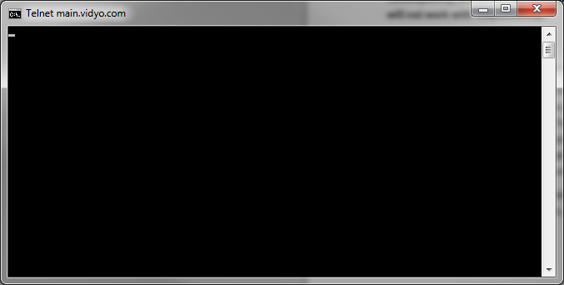
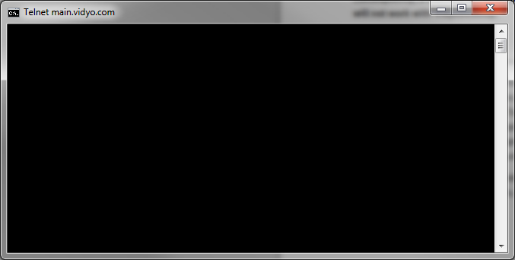
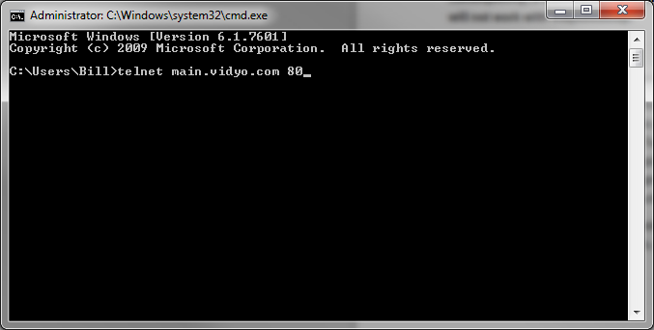
Unable to Browse to Portal or Login
Firewall issues can cause the following issues:
Sign-in issues – unable to connect to the VidyoManager
User cannot join a conference call – unable to connect to the VidyoRouter
Disconnect during a conference call – due to UDP traffic termination/timeout
Use ‘Telnet’ to determine if ports are open.
‹#›

Slide 14
Problem Downloading, Installing or Running VidyoDesktop
Does the VidyoPortal prompt you to download VidyoDesktop?
Does the installer download?
Do you have administrative privileges to install new software?
Please reference the VidyoDesktop Troubleshooting Flowchart (click here)
‹#›

Slide 15
Problem Connecting VidyoDesktop: Not Fully Registered, Problems Starting VidyoConference
Is the person icon next to your name on the VidyoPortal homepage green?
Do you see VidyoDesktop icon in your system tray (Windows) or in Dock (Mac)?
Please reference the VidyoDesktop Troubleshooting Flowchart (click here)
‹#›

Slide 16
Review - Common Causes of Connectivity Issues
Firewall and Security Applications
Required Vidyo ports are not open
Vidyo applications are not set as trusted applications
Vidyo servers behind a NAT are not properly configured
‹#›

Slide 17
Review - Common Causes of Connectivity Issues
Web Proxy
VidyoDesktop web proxy settings are not configured properly (e.g. missing required username and password)
Web Proxies that rely on PAC scripts are not properly set
‹#›

Slide 18
Review - Common Causes of Connectivity Issues
HTTPS/SSL
Vidyo infrastructure and/or endpoint components are missing the required certificates
Certificates are expired, revoked or not issued by a valid CA
VidyoPortal’s LDAP settings are not properly configured
Network connectivity issue between the VidyoPortal and the LDAP server
‹#›

Slide 19
Common VidyoDesktop Performance Issues

Slide 20
Common VidyoDesktop Performance Issues
No Audio – Cannot Hear Others
No Audio – Remote Participants Cannot Hear Me
Hearing Echo on the Call
No Video – Cannot See My Camera
No Video – DirectX Error or Black Window (with others joined)
Video Quality is Poor/Choppy/Freezing
‹#›

Slide 21
No Audio – Cannot Hear Others
Is the speaker icon in the VidyoDesktop application toolbar red (muted)?
Is it only one participant that you cannot hear or all participants?
Are others able to hear the participant?
Please reference the VidyoDesktop Troubleshooting Flowchart (click here)
‹#›

Slide 22
No Audio – Remote Participants Cannot Hear Me
Is the microphone icon in the VidyoDesktop application toolbar red (muted)?
Is it only one or all participants who cannot hear me?
If only one, can this participant not hear others or only you?
Are you sending audio bandwidth?
Please reference the VidyoDesktop Troubleshooting Flowchart (click here)
‹#›

Slide 23
Hearing Echo On the Call
Does anyone on the call not hear the echo?
If only one person does not hear the echo, does that user have a headset or speakerphone with built-in echo cancellation?
If not, have you tried enabling software echo cancellation within the VidyoDesktop device settings?
Please reference the VidyoDesktop Troubleshooting Flowchart (click here)
‹#›

Slide 24
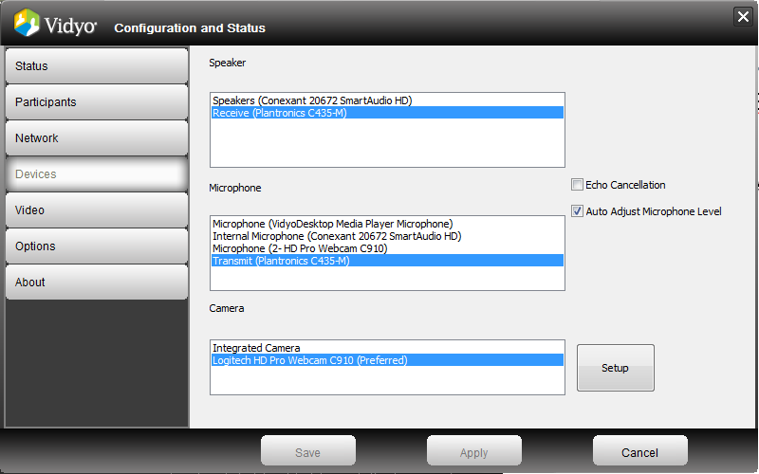
Hearing Echo On the Call
Using a laptop’s integrated mic/speaker without enabling VidyoDesktop’s software echo cancellation may cause echo
‹#›

Slide 25
No Video – Cannot See My Camera
Can you see your local preview in VidyoDesktop?
Is your camera plugged in?
Is there another application using the camera?
Is the proper camera selected?
Please reference the VidyoDesktop Troubleshooting Flowchart (click here)
‹#›

Slide 26
No Video – DirectX Error or Black Window (with others joined)
Is the user receiving an error?
Does the call stay connected and can you hear others?
Is the VRAM 128MB or higher?
Is DirectX 9.0c or higher installed?
Are DirectDraw AND Direct3D acceleration enabled?
Please reference the VidyoDesktop Troubleshooting Flowchart (click here)
‹#›

Slide 27
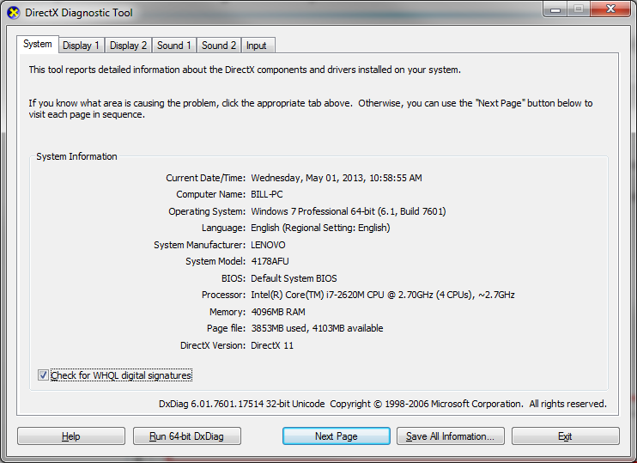
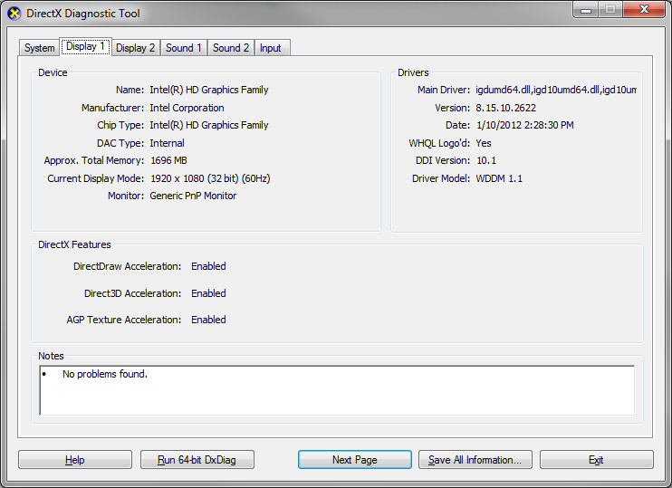
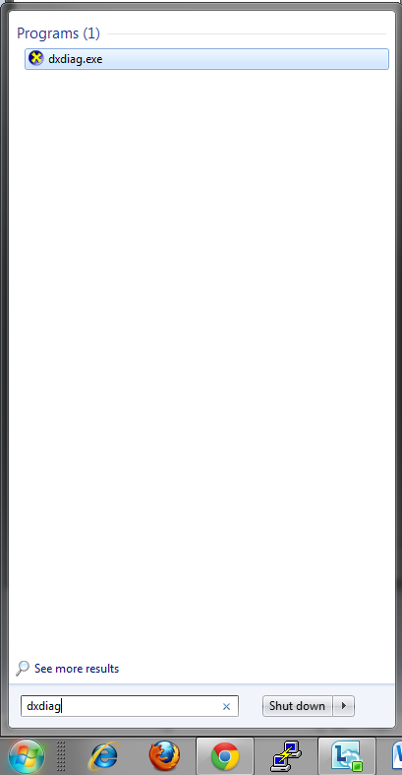
No Video – DirectX Error or Black Window (with others joined)
Run ‘dxdiag’ from the run or search programs and files prompt
‹#›

Slide 28
Audio/Video Quality is Poor/Choppy/Freezing
Is the issue experienced by all, a group or a single participant?
Do the affected have sufficient bandwidth and CPU resources?
Is VidyoProxy being used?
Is there an alarm being generated?
Please reference the VidyoDesktop Troubleshooting Flowchart (click here)
‹#›

Slide 29
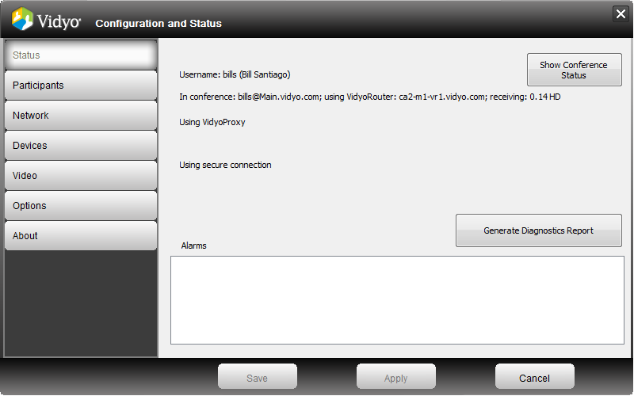
Audio/Video Quality is Poor/Choppy/Freezing
Is the user connected via VidyoProxy?
‹#›

Slide 30
Audio/Video Quality is Poor/Choppy/Freezing
VidyoDesktop Alarms
VidyoDesktop alarms will be generated when a performance issue is detected
When at least one alarm raised, the configuration button on main VidyoDesktop window will turn red
VidyoDesktop alarm details appear at the bottom of the Status tab, within the Configuration and Status dialog
Alarm Examples:
High CPU utilization limits quality of conference
Insufficient network send bandwidth limits quality of own video
Insufficient network send bandwidth limits resolution of own video
Insufficient network receive bandwidth limits number of viewable participants
‹#›

Slide 31
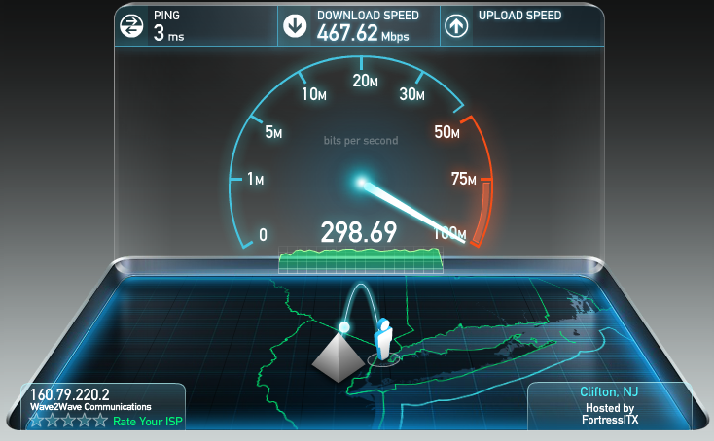
Audio/Video Quality is Poor/Choppy/Freezing
Network Bandwidth
Insufficient bandwidth will impact performance generate VidyoDesktop alarms
Conduct a speed test (e.g. www.speedtest.net)
2Mbps down/1Mbps up should be sufficient for a ‘good’ experience
‹#›

Slide 32
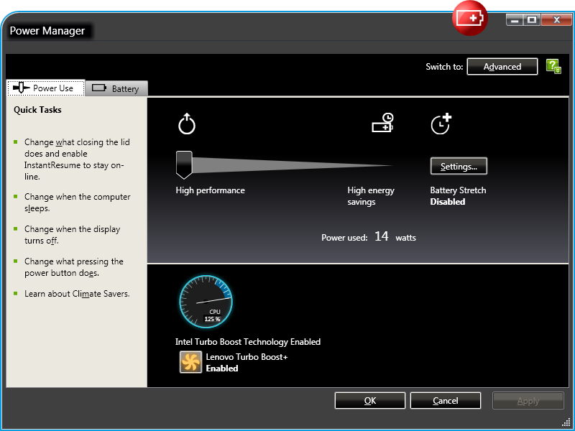
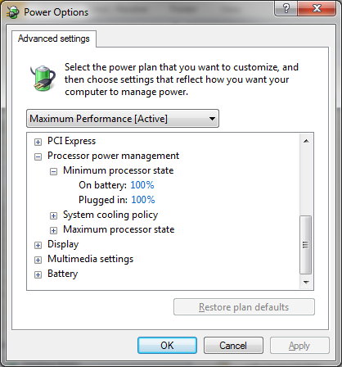
Audio/Video Quality is Poor/Choppy/Freezing
CPU Power Plan
To ensure optimal performance, use High/Maximum Performance Power Plan when plugged in
Avoid ‘Battery Saver’ power plans when plugged in as they can throttle your CPU resources
‹#›

Slide 33
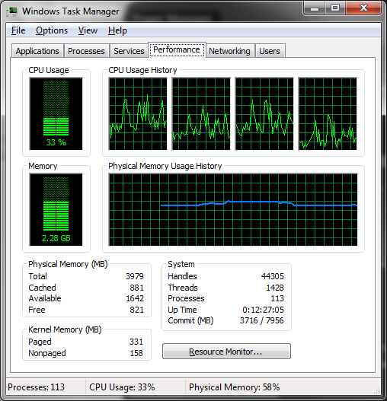
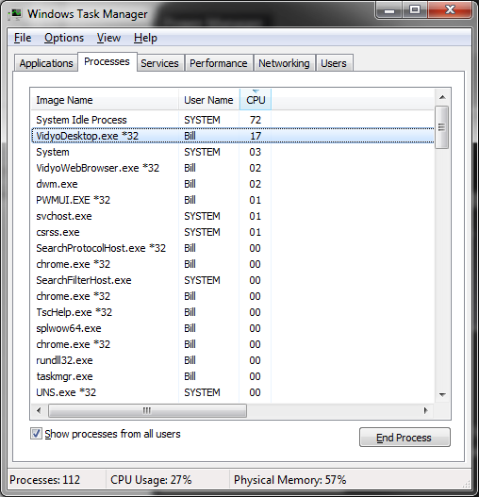
Audio/Video Quality is Poor/Choppy/Freezing
Check CPU utilization in task manager
An alarm may be generated if the CPU utilization is above 90%
‹#›

Slide 34
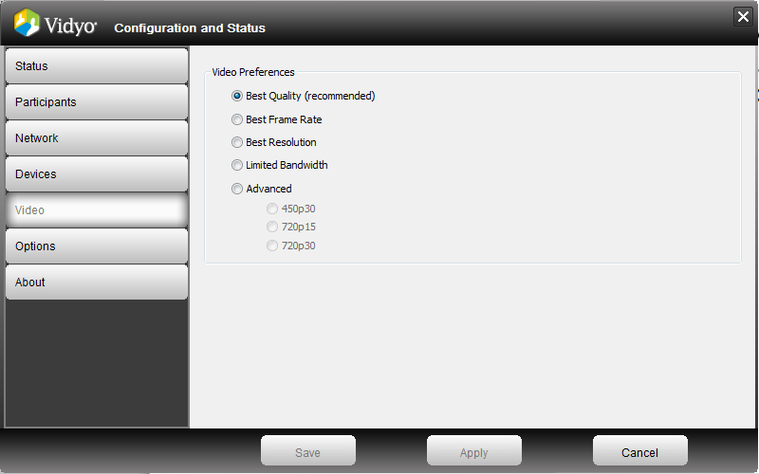
Audio/Video Quality is Poor/Choppy/Freezing
Video Preferences
Use the recommended ‘Best Quality’ option to avoid performance issues
Users may force 720p30 without fully understanding the impact that it will have on their CPU
Users may force Limited Bandwidth, which will limit their transmit resolution
‹#›

Slide 35
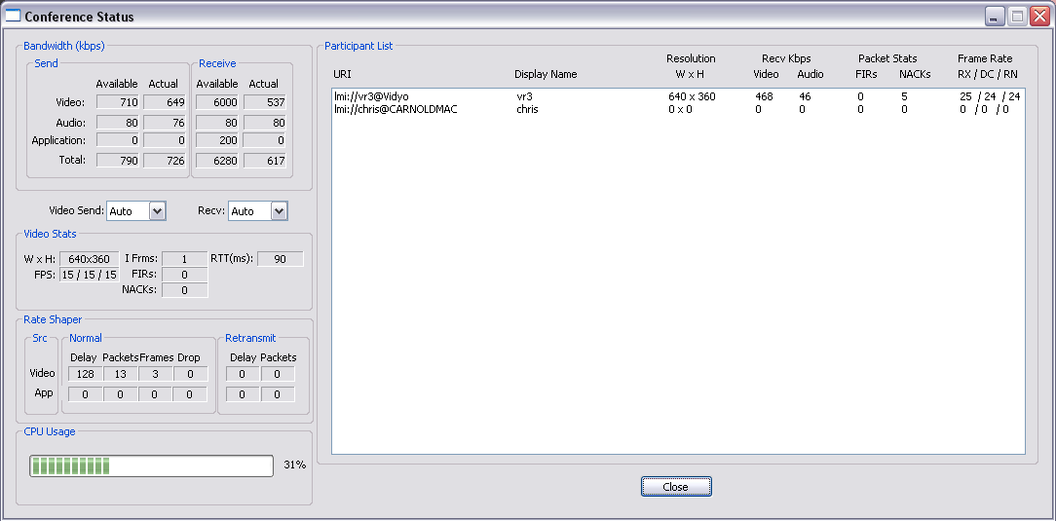


Audio/Video Quality is Poor/Choppy/Freezing
Network – Quality (e.g. Packet loss, latency)
Check Conference Status for NACKs
NACKs are an indication of UDP packet loss
These NACKs typically represent a problem between the receiver and the VidyoRouter representing that user’s video
These NACKs typically represent a problem between you and the VidyoRouter
‹#›
‹#›
‹#›

Slide 36
Audio/Video Quality is Poor/Choppy/Freezing
What is a FIR?
Full Intra Request
H.264
What causes FIRs?
Video starts
Active speaker/layout changes
Significant packet loss
These FIRs you received from other participants (senders)
These FIRs come from the VidyoRouter
‹#›

Slide 37
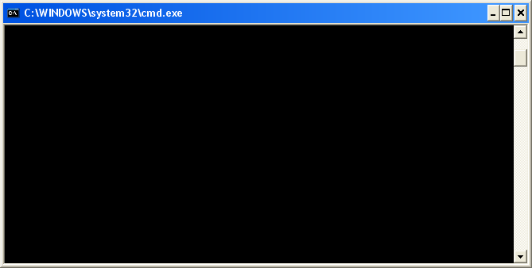
Audio/Video Quality is Poor/Choppy/Freezing
Ping VidyoRouter while not in a conference call (ping –l 1300 IP/URL –t)
Check for latency under 200ms
Check that latency is consistent
No time outs
Microsoft Windows XP [Version 5.1.2600]
(C) Copyright 1985-2001 Microsoft Corp.
C:\Documents and Settings\Ami>ping demo.vidyo.com -t
Pinging demo.vidyo.com [64.208.203.165] with 32 bytes of data:
Reply from 64.208.203.165: bytes=32 time=95ms TTL=47
Reply from 64.208.203.165: bytes=32 time=96ms TTL=47
Reply from 64.208.203.165: bytes=32 time=97ms TTL=47
Reply from 64.208.203.165: bytes=32 time=95ms TTL=47
Reply from 64.208.203.165: bytes=32 time=96ms TTL=47
Reply from 64.208.203.165: bytes=32 time=97ms TTL=47
Reply from 64.208.203.165: bytes=32 time=95ms TTL=47
Reply from 64.208.203.165: bytes=32 time=95ms TTL=47
Reply from 64.208.203.165: bytes=32 time=95ms TTL=47
Reply from 64.208.203.165: bytes=32 time=95ms TTL=47
Reply from 64.208.203.165: bytes=32 time=95ms TTL=47
‹#›
‹#›

Slide 38
Audio/Video Quality is Poor/Choppy/Freezing
Ping server while in call
High latency > 200ms
Multiple time outs
Wide range of latencies
What does this tell us?
The link “seems” ok when there’s no video traffic
Link works ok over long lengths of time
Link breaks down when constant low latency traffic starts (i.e. video / audio)
What kind of connection?
Wired or wireless?
Cable, DSL, T1?
Check for other programs using the network (Outlook, Downloading movies, etc…)
Check for other users on the network using bandwidth
Microsoft Windows XP [Version 5.1.2600]
(C) Copyright 1985-2001 Microsoft Corp.
C:\Documents and Settings\Ami>ping demo.vidyo.com -t
Pinging demo.vidyo.com [64.208.203.165] with 32 bytes of data:
Reply from 64.208.203.165: bytes=32 time=95ms TTL=47
Observe video during ping
Watch for video freezing
during time out
Reply from 64.208.203.165: bytes=32 time=144ms TTL=47
Reply from 64.208.203.165: bytes=32 time=112ms TTL=47
Reply from 64.208.203.165: bytes=32 time=203ms TTL=47
Request timed out
Reply from 64.208.203.165: bytes=32 time=97ms TTL=47
Request timed out
Reply from 64.208.203.165: bytes=32 time=95ms TTL=47
Reply from 64.208.203.165: bytes=32 time=234ms TTL=47
Reply from 64.208.203.165: bytes=32 time=143 TTL=47
Reply from 64.208.203.165: bytes=32 time=95ms TTL=47
‹#›
‹#›

Slide 39
Audio/Video Quality is Poor/Choppy/Freezing
Outdated Camera, Video and Audio Drivers May Impact Performance
Driver version/date can be obtained from the Dxdiag log that is included with the VidyoDesktop log zip file
Drivers older than a couple of years old should be updated if the user is experiencing hardware performance issues
‹#›

Slide 40
Audio/Video Quality is Poor/Choppy/Freezing
VPNs can cause the following issues:
Connectivity or performance issues
Can limit bandwidth due to encryption overhead
Latency due to routing
Can limit the MTU size
‹#›

Slide 41
Audio/Video Quality is Poor/Choppy/Freezing
Is a Web Proxy being used?
By default, VidyoDesktop is set up to ‘Use settings from Internet Explorer’
The VidyoProxy feature must be configured in order for VidyoDesktop to establish a connection though a Web Proxy server
To avoid performance issues due to Web Proxies inspecting media packets, it is highly recommended to create exceptions (e.g. Bluecoat) or allow DIRECT connections to the Vidyo infrastructure (bypassing the Web Proxy). In many occasions, this can be accomplished by simply editing the PAC script.
‹#›

Slide 42
Review - Common Causes of VidyoDesktop Performance Issues
Network
Insufficient bandwidth, quality (e.g. Packet Loss, Latency)
Firewall, VPN, Web Proxy
‹#›

Slide 43
Review - Common Causes of VidyoDesktop Performance Issues
VidyoDesktop Settings
Using integrated mic/speaker (without enabling VidyoDesktop’s software echo cancellation)
Enabling VidyoDesktop’s software echo cancellation when using devices with built-in hardware echo cancellation
The use of proxy
‹#›

Slide 44
Review - Common Causes of VidyoDesktop Performance Issues
Hardware
Optimal Power Plan not set
720p@30fps Option Enabled
CPU Load (additional CPU intensive applications are running during a conference call)
CPU Specifications (minimum requirements not met)
Not enough memory resources - 1GB RAM and 128MB Video RAM (VRAM)
‹#›

Slide 45
Review - Common Causes of VidyoDesktop Performance Issues
Software
Outdated Drivers (audio card, video card, camera)
DirectX 9.0c (minimum)
Missing Flash plug-in
‹#›

Slide 46
Common VidyoRoom Issues

Slide 47
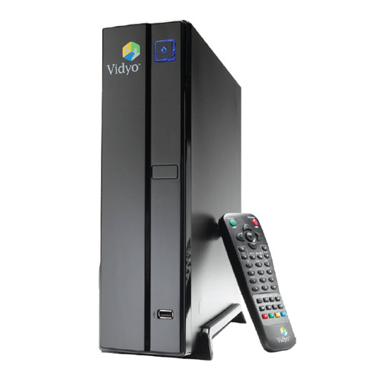
Common VidyoRoom Issues
Unable to Power Up VidyoRoom
Unable to Connect to VidyoPortal
USB Audio Device is Not Working (No Audio)
No Video
Camera Not Responding to VidyoRemote
Share Device Not Working
‹#›

Slide 48
Unable to Power Up VidyoRoom
Have you tried disconnecting all of the cables and solely connecting the power and video cables to see if the system powers up?
Do you see a blue light on the power button on the front of the VidyoRoom system?
Please reference the VidyoRoom Troubleshooting Flowchart (click here)
‹#›

Slide 49
Unable to Connect to VidyoPortal
Are you viewing the account settings page?
Are you receiving an error message?
Is the VidyoPortal using HTTPS/SSL?
Are you able to browse to the VidyoPortal address from another computer using the same network and cable?
Are you using a VidyoRoom account (vs Normal)?
Is the VidyoRoom set up to use the appropriate IP (if static) and network settings?
Please reference the VidyoRoom Troubleshooting Flowchart (click here)
‹#›

Slide 50
USB Audio Device is Not Working (No Audio)
Is the VidyoRoom set to use USB audio (does not apply to v2.2.x as they use automatic selection)?
Have you tried connecting the USB audio device to another USB port?
Have you ensured that the system’s mic and speaker are not muted?
Have you tested the USB audio device on another computer?
Please reference the VidyoRoom Troubleshooting Flowchart (click here)
‹#›

Slide 51
No Video (from VidyoRoom camera)
Are you able to see video when self-view is activated?
Have you made sure that privacy mode (camera mute) is not active?
If using a Sony EVI-HD series camera, have you made sure that the SYSTEM SELECT is set to the appropriate resolution and frame rate (matching what the VidyoRoom system is set to transmit via its video settings – use the VISCA option if you want the VidyoRoom to set the resolution and frame rate to the camera)?
Is the camera connected to the VidyoRoom’s video capture card port (reference VidyoRoom admin guides for connection diagrams)?
Please reference the VidyoRoom Troubleshooting Flowchart (click here)
‹#›

Slide 52
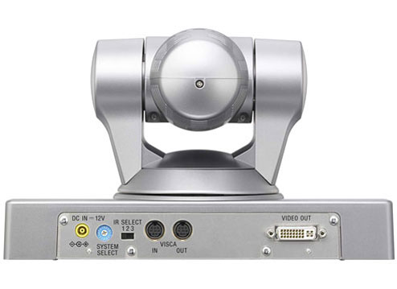
No Video (from VidyoRoom camera)
Ensure that the camera is connected to the video capture card interface
If using a Sony EVI-HD series camera, please make sure that SYSTEM SELECT is either set to VISCA or set to the correct resolution and frame rate matching what the VidyoRoom system is set to encode
NOTE: If you prefer to set a resolution and frame rate on the camera, you will find a table at the bottom of the Sony EVI-HD series that defines each numbered option
Make sure that the VidyoRoom system’s camera mode is set to a resolution/framerate that is supported by the camera (e.g. 1080p15 is not supported by the Sony EVI-HD series cameras)
‹#›

Slide 53
Camera Not Responding to VidyoRemote
Is the VidyoRoom’s remote control able to control other functions of the VidyoRoom?
Have you ensure that the VidyoRoom is set to the proper IR receiver setting (e.g. internal vs external IR)?
Is the USB end of the VISCA to USB cable connected to the labeled ‘CAM CTRL’ USB port on the rear of the VidyoRoom system?
If using a Sony EVI-HD series camera, did you make sure that the VISCA end of the VISCA to USB cable is connected to the ‘VISCA In’ port?
Please reference the VidyoRoom Troubleshooting Flowchart (click here)
‹#›

Slide 54
Camera Not Responding to VidyoRemote
Ensure that USB to VISCA cable is connected to the correct ports – the USB port is labeled on the VidyoRoom and when using the Sony EVI-HD series cameras, you must use the ‘VISCA In’ port
Ensure that the USB end of the VISCA to USB cable connected to the labeled ‘CAM CTRL’ USB port on the rear of the VidyoRoom system
Also, FECC option must be enabled to allow others in the conference call to control the VidyoRoom’s camera
‹#›

Slide 55
Share Device Not Working
Have you ensured that the computer that you are connecting to the USB to VGA/DVI share device is outputting its video signal (secondary display should be enabled)?
Is the user in a conference call (share will not start unless you’re in a conference call – this will change in v2.2.2, which has not been released as of yet)?
Have you made sure that the USB end of the share device is NOT connected to the USB port that is labeled ‘CAM CTRL’?
Please reference the VidyoRoom Troubleshooting Flowchart (click here)
‹#›

Slide 56
VidyoRoom - Echo
If using line-in/out for audio, please make sure that the customer is using a separate echo cancellation device (speakerphones with hardware echo cancellation is an alternative)
If using line-out from the Interact AT solution, the Interact software must be configured to enable echo cancellation when outputting to an external amplified or powered speaker
‹#›

Slide 57
VidyoRoom – Poor Video (send)
Check transmit bandwidth setting on VidyoRoom system to ensure that it is not set too low
Run a speed test on the network that the VidyoRoom is using to determine if the VidyoRoom system has sufficient bandwidth
‹#›

Slide 58
VidyoRoom – Poor Video (receive)
Run a speed test to determine if the VidyoRoom system has sufficient bandwidth
Ensure that the VidyoRoom system is properly ventilated. Make sure that the provided stand is being used if the system is installed upright (vertical).
‹#›

Slide 59

VidyoRoom - Wrong Input Mode w/ Physical Keyboard
Undesirable characters/symbols will appear when using a physical keyboard with the incorrect input mode set
Press the blue ‘D’ button on the VidyoRoom’s remote control to toggle between Multi-tap (T9) and Numeric input modes (use Numeric mode when using a physical keyboard)
‹#›

Slide 60
Common VidyoGateway Issues

Slide 61
Common VidyoGateway Issues
Unable to Connect to H.323 Endpoint
Unable to Connect to Legacy SIP Endpoint
SIP endpoint cannot connect to a Vidyo hosted conference (room)
‹#›

Slide 62
Unable to Connect to Legacy H.323 Endpoint
Does the VidyoPortal display the VidyoGateway‘s virtual endpoints?
Are you using the correct dial string for the device that you are calling?
Does the call connect at all?
Does the call connect but drops immediately?
Please reference the VidyoGateway Troubleshooting Documents (click here)
‹#›

Slide 63
Unable to Connect to Legacy H.323 Endpoint
Does the call connect but you cannot hear audio nor see video?
Does the call connect but drop consistently after ‘x’ amount of time?
Does the call connect and only audio comes through?
Does the call connect and only video comes through?
Please reference the VidyoGateway Troubleshooting Documents (click here)
‹#›

Slide 64
Unable to Connect to Legacy SIP Endpoint
Cannot make outbound calls to SIP endpoint
Confirm outbound dialing string (Vidyo do not support URI dialing that requires SRV lookup)
Check gateway SIP Configuration settings in gateway.
Is there a SIP server address configured.
If so, is SIP endpoint registered with configure SIP server
Verify SIP INVITE is being sent to destination endpoint.
Start capture
Make test call
Stop Capture
Download log
Send logs to Vidyo Support
‹#›

Slide 65
SIP Endpoint Cannot Connect to a Vidyo Hosted Conference (room)
Cannot connect inbound SIP endpoint to Vidyo.
Confirm proper gateway outbound dialing string.
Verify if the SIP endpoint is able to connect to other SIP endpoints that are on or similar networks as the VidyoGateway.
Make sure you are trying to connect over UDP not TCP (gw only supports UDP)
Verify that call reaches gateway.
Start Capture
Make test call
Stop Capture
Download log
Send logs to Vidyo Support
Is the SIP endpoint registered to a SIP server or registrar and is it allowed to make outbound calls.
‹#›

Slide 66
Gathering General Information and Vidyo Logs

Slide 67
Gathering General Information (history and current symptoms)
Exactly when did the user encounter the problem?
Has the user ever been operational?
What are the symptoms that the user is experiencing?
Is the user experiencing any error messages or alarms and if so, what is the exact syntax of the error message(s)?
Are any other users experiencing the problem?
‹#›

Slide 68
Gathering General Information (history and current symptoms)
Has anything changed (e.g. location, endpoint hardware, accessories, network, firewall, software update)?
Can the user recreate the problem?
What version(s) are running on the involved infrastructure components and endpoint(s) (VidyoDesktop, VidyoPortal, VidyoRouter, etc.) ?
Consider gathering information via TeamViewer
‹#›

Slide 69
Gathering Vidyo Logs
VidyoDesktop
VidyoRoom
VidyoGateway
‹#›

Slide 70
Gathering Logs
Reported Issue | Required Logs | Notes
Error installing VidyoDesktop | VidyoDesktop / VidyoRoom Logs | Include computer type, OS version, and screenshots of any error messages.
Connecting to VidyoPortal Issues | VidyoDesktop / VidyoRoom Logs | Include computer type, OS version, and screenshots of any errors, as well as type of antivirus/ security application.
Problem starting Vidyo call | VidyoDesktop / VidyoRoom Logs | Screenshots of any errors, as well as type of antivirus/security application.
Audio issues | VidyoDesktop / VidyoRoom Logs | Include types of audio devices.
Quality issues | VidyoDesktop / VidyoRoom Logs | Include group setting, if known, as well as available bandwidth.
‹#›

Slide 71
Gathering Logs
Video issues | VidyoDesktop / VidyoRoom Logs | Notes
Content sharing issues | VidyoDesktop / VidyoRoom Logs
DirectX error | VidyoDesktop / VidyoRoom Logs
VidyoDesktop disconnect issues | VidyoDesktop / VidyoRoom Logs | Support may need VidyoManager logs as well. Screenshots of any errors, as well as the name and version numbers of any antivirus or other security application.
Issues with calls to/from H.323/SIP system | VidyoGateway and VidyoDesktop/VidyoRoom Logs
VidyoPortal shows component down | Component log – VidyoManager, VidyoRouter, etc.
‹#›

Slide 72
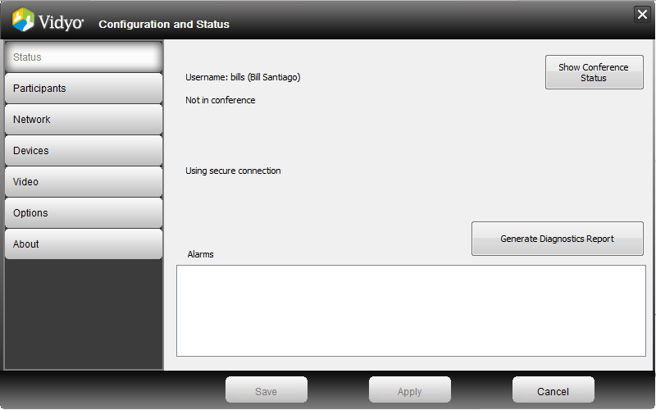
Gathering Logs - Vidyo Diagnostics Report
Click the ‘Generate Diagnostics Report’ button
The logs will be zipped and saved to the user’s Desktop
Please specify the date/time that the issue occurred when you escalate the issue
‹#›

Slide 73
VidyoMobile Logs
Android devices can send their logs directly from the VidyoMobile application
IOS devices output their logs to iTunes
VidyoMobile log capturing instructions are provided in the Getting Help section of the VidyoMobile User Guide
Please reference the VidyoMobile User Guides (click here)
‹#›

Slide 74
Linux Logs
Linux log capturing instructions are provided in the VidyoDesktop User Guide (page 72)
‹#›

Slide 75
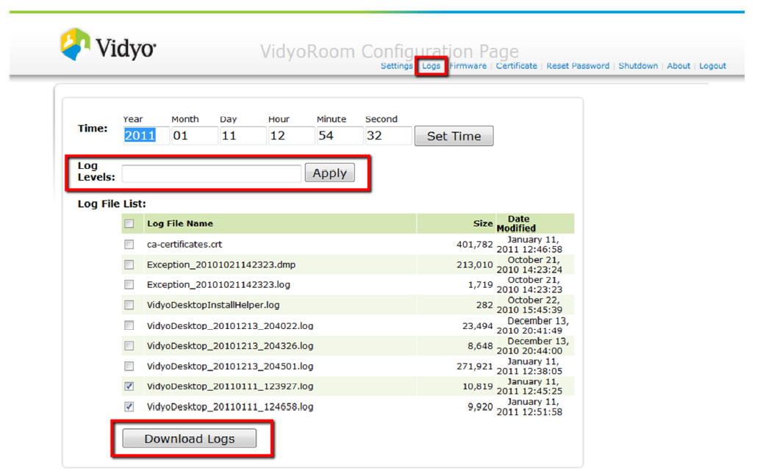
Gathering Logs - VidyoRooms
Vidyo Support will let you know if changing log levels are necessary
‹#›

Slide 76
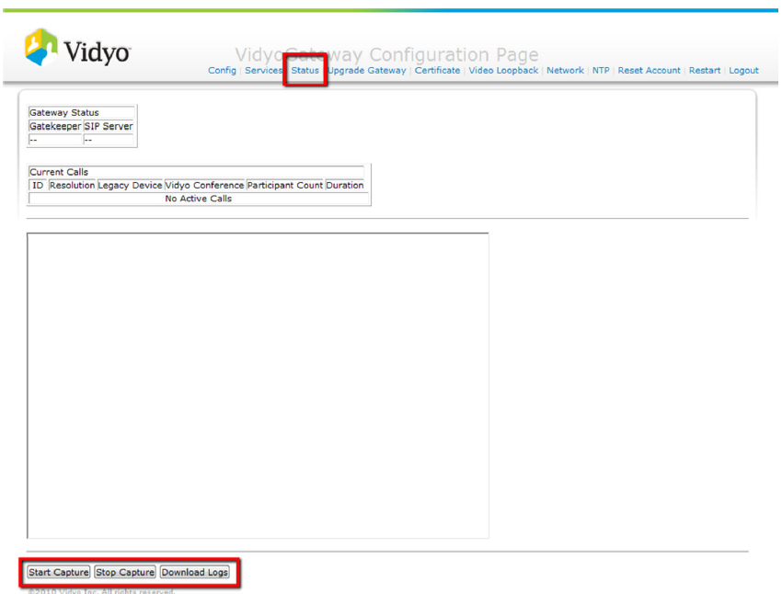
Gathering Logs - VidyoGateway
The goal with obtaining VidyoGateway log files is to start the capture, recreate the issue and immediately stop the capture once the issue has been recreated.
Please make sure that you capture the *.pcap file as part of the capture before sending the zipped log file to Vidyo Support
‹#›

Slide 77
Gathering Logs – Infrastructure Components
In most cases, VidyoDesktop logs are sufficient for Vidyo to determine the cause of connectivity and/or performance issues (when basic troubleshooting has been exhausted)
For issues that impact a conference call (all participants), please include the VidyoManager and VidyoRouter(s) log file(s)
Please reference the Vidyo Troubleshooting Assistance document (click here)
‹#›

Slide 78
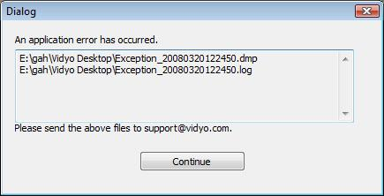
Vidyo Desktop Exception Dialog
If VidyoDesktop crashes, an exception log will be generated.
Please send (preferably using ZIP) the entire directory content:
Path is \My documents\VidyoDesktop\*.*
‹#›

Slide 79
VidyoDesktop DOs and DON’Ts Checklist
To help ensure the best Vidyo experience, please follow these guidelines:
Be aware when using wireless connections, wired will always be best
Make sure that when wired, wireless is disabled
Check Camera FPS settings
Avoid analog recording and playback devices
Use a USB Headset or echo cancelling speakerphone (digital) vs. analog sound card
DO NOT use a USB hub for camera and headset
Check PC power settings, avoid power save if not plugged in
Beware VPN software (may block ports or redirect traffic thru VPN)
Beware personal Firewall/Malware clients
‹#›

Slide 80
Vidyo Escalation Best Practices

Slide 81
Vidyo Escalation Best Practices
Support Level Overview
Contacting Vidyo Support Best Practices
‹#›

Slide 82
Support Levels
Support Level | Responsibility
Tier 1 | End-User
Tier 2 | Designated Trained Personnel - Partner
Tier 2, 3 & 4 | Vidyo
Escalations to Vidyo Support must come from designated trained personnel
The service is provided according to the service plan acquired
‹#›

Slide 83
Contacting Support
By phone:
North and South Americas: + 1 866 99 VIDYO
France, Rest of EMEA, India : + 33 975 18 19 00
Italy: +39 0699266512
United Kingdom: +44 2035141783
Online at https://selfservice.vidyo.com/
By email:
emeasupport@vidyo.com
support@vidyo.com
apjsupport@vidyo.com
‹#›

Slide 84
Contacting Support Best Practices
Creating and managing your cases via Vidyo’s Self-Service Portal (https://selfservice.vidyo.com/) provides the following benefits:
Visibility of all of your organization’s cases
Centralizes communication between your team and the Vidyo Support Team
If you do not have access to Vidyo’s Self-Service Portal (for direct partners and end uses with Plus level support), please email emeasupport@vidyo.comIf you do not have access to Vidyo’s Self-Service Portal (for direct partners and end uses with Plus level support), please email emeasupport@vidyo.com (EMEA only) or iteam@vidyo.com (for all others)
‹#›

Slide 85
Contacting Support Best Practices
Call us for URGENT requests
Severity 1 & Severity 2 requests shall be handled via phone support
Avoid sending emails directly to one of our support engineers as they could be in the field or assisting other customers
RMA/ARMA requests - the best way to expedite the request is to make sure we have the following information:
Serial number
Software version
Return address
‹#›

Slide 86
Escalation Procedures
When escalating an issue, please include the following information:
Details regarding the symptoms that the user is experiencing
Time and date
VidyoDesktop Diagnostics Report (includes hardware used)
Vidyo Infrastructure and VidyoDesktop version and OS version
Screenshots and error message pop-up (please provide the exact error syntax)
‹#›

Slide 87
Response Times
Phone requests
URGENT issues (S1 and S2) such as outages, high impact issues or any issue that requires our immediate attention
Immediately acknowledged by a support representative
CS Engineer is available within up to 2 hours from the original call
Self-Service Portal and Email requests
Response time for email requests is up to one business day

Slide 88
Additional Resources
Additional technical notes, firmware updates and security patches are also available on http://support.vidyo.com
Admin and user guides are available within the admin and user interfaces
Super Admin and Admin Interfaces (click the ?)
VidyoPortal user interface (click help)
‹#›

Slide 89
Additional Resources
Vidyo Certified Deployment and Support (VC-DSE) Training Videos (available on Self-Service Portal)
Infrastructure Setup (VidyoPortal, VidyoRouter, VidyoGateway and VidyoReplay)
Super Admin and Admin Training
Hot Standby Configuration
Additional topics coming soon!
Version 2.2 Product Manuals are also available within the Support \ Documentation section of www.vidyo.comavailable within the Support \ Documentation section of www.vidyo.com (click here)
‹#›

Slide 90

You Should Now Be Able To:
Describe the Vidyo Call Flow
Troubleshoot Common Vidyo Issues
Properly escalate issues to Vidyo Support
Access additional troubleshooting resources when needed
‹#›

Slide 91

Questions
‹#›

